Slide 1
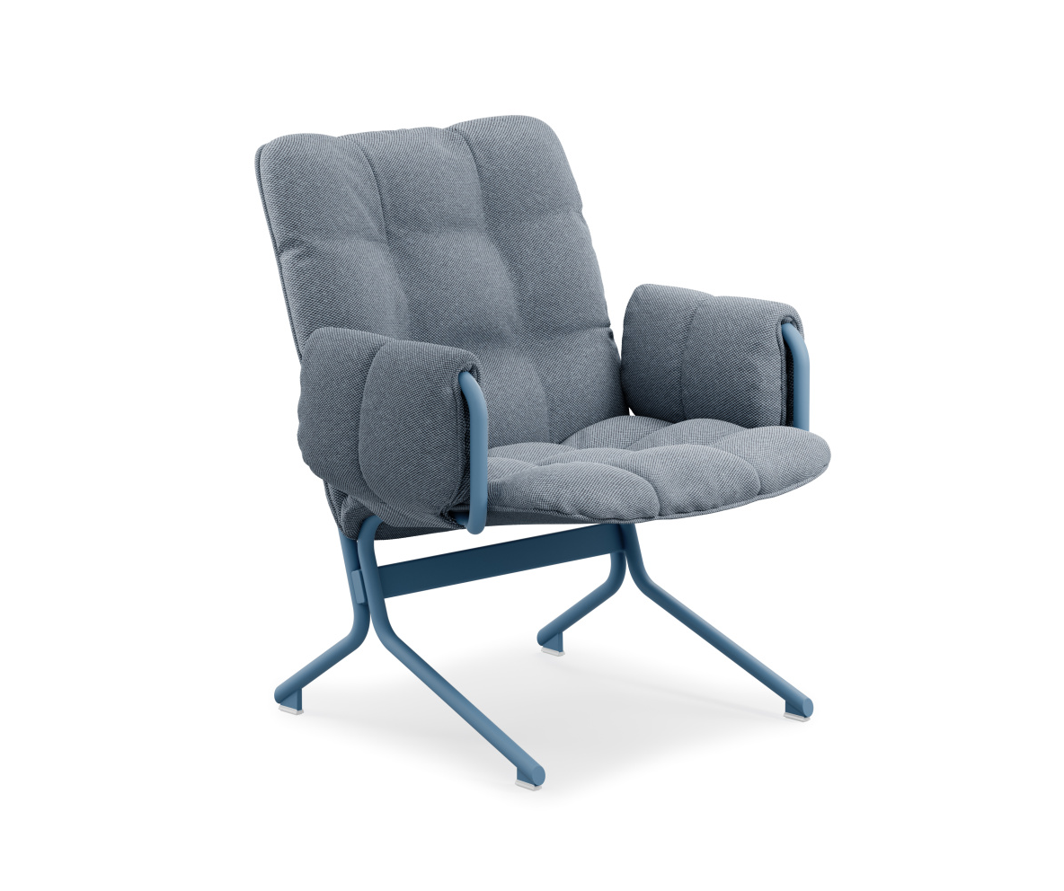
How to dispose of product
- Profim Snap
Please Note: This product is designed for easy disassembly!
Assess the furniture condition.
Flokk provides spare parts for easy replacement of worn-out components
Consider donating or selling if in good condition.

Slide 2
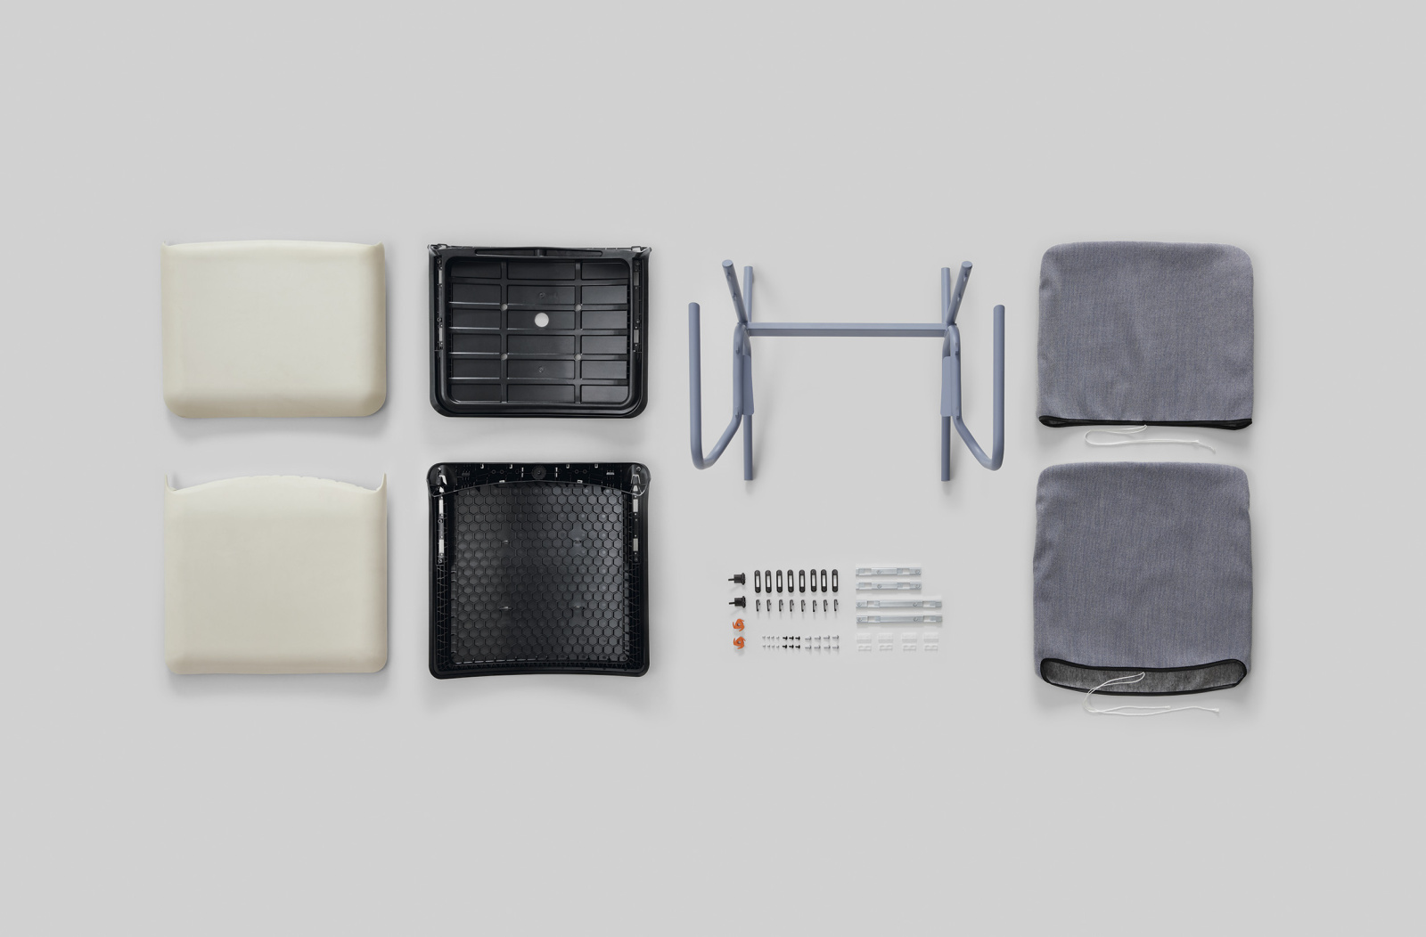
How to dispose of product
- Profim Snap
Please Note: This product is designed for easy disassembly!
RECYCLING - disassemble the chair into its separate materials.
Recycling is the best option for this product, the ability to separate different materials makes segregation easy here.
Return to / contact your local waste management service.
In case of product damage or inability to disassemble, please contact your local waste management service for proper material disposal.

